Slide 1



UNIVERSITY INSTITUTE OF ENGINEERING
COMPUTER SCIENCE ENGINEERING
Bachelor of Engineering
Design and Analysis of Algorithms(CST-302/ITT-302)
Prepared By: Amrita Chaudhary (E8745)
Topic: Complexity Analysis
DISCOVER . LEARN . EMPOWER

Slide 2
Learning Objectives & Outcomes
Objective:
To understand meaning of Complexity analysis and why it is needful to perform analysis of algorithm
Outcome:
Student will understand the time and space complexity of algorithms.
Also understand the different asymptotic notations.

Slide 3
Complexity of Algorithm
In designing of Algorithm, complexity analysis of an algorithm is an essential aspect. Mainly, algorithmic complexity is concerned about its performance, how fast or slow it works.
The complexity of an algorithm describes the efficiency of the algorithm in terms of the amount of the memory required to process the data and the processing time.
It is very convenient to classify algorithm based on the relative amount of time or relative amount of space they required and specify the growth of time/space requirement as a function of input size.

Slide 4
Time Complexity
It’s a function describing the amount of time required to run an algorithm in terms of the size of the input.
"Time" can mean the number of memory accesses performed, the number of comparisons between integers, the number of times some inner loop is executed, or some other natural unit related to the amount of real time the algorithm will take.

Slide 5
Space Complexity
Some forms of analysis could be done based on how much space an algorithm needs to complete its task. This space complexity analysis was critical in the early days of computing when storage space on the computer was limited. When considering this algorithm are divided into those that need extra space to do their work and those that work in place.
But now a day's problem of space rarely occurs because space on the computer (internal or external) is enough.

Slide 6
Types of analysis
Following types of analysis –
Worst-case: f (n) defined by the maximum number of steps taken on any instance of size n.
Best-case: f (n) defined by the minimum number of steps taken on any instance of size n.
Average case: f (n) defined by the average number of steps taken on any instance of size n.

Slide 7
Asymptotic Notations
Execution time of an algorithm depends on the instruction set, processor speed, disk I/O speed, etc. Hence, we estimate the efficiency of an algorithm asymptotically.
Time function of an algorithm is represented by T(n), where n is the input size.
Different types of asymptotic notations are used to represent the complexity of an algorithm. Following asymptotic notations are used to calculate the running time complexity of an algorithm.
    O − Big Oh
    Ω − Big omega
    θ − Big theta
    o − Little Oh
    ω − Little omega

Slide 8
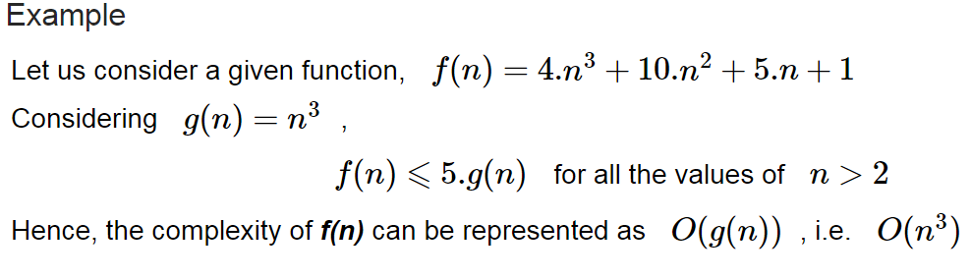
Big-oh notation (O) (Asymptotic Upper Bound)
‘O’ (Big Oh) is the most commonly used notation. A function f(n) can be represented is the order of g(n) that is O(g(n)), if there exists a value of positive integer n as n₀ and a positive constant c such that −
Hence, function g(n) is an upper bound for function f(n), as g(n) grows faster than f(n).

Slide 9
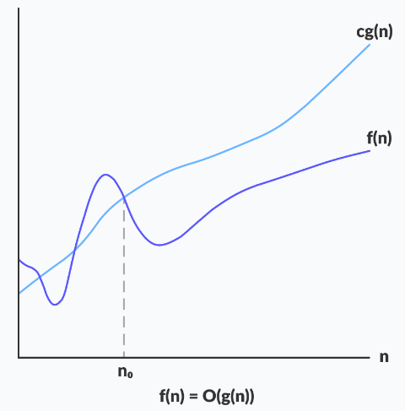

Slide 10
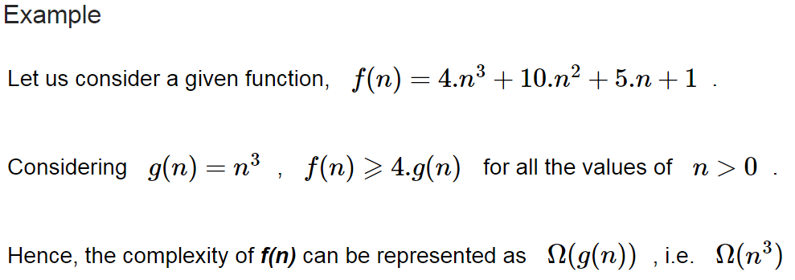
Omega Notation(Ω) (Asymptotic Lower Bound)
We say that f(n)=Ω(g(n)) when there exists constant c that f(n)⩾c.g(n) for all sufficiently large value of n. Here n is a positive integer. It means function g is a lower bound for function f; after a certain value of n, f will never go below g.

Slide 11
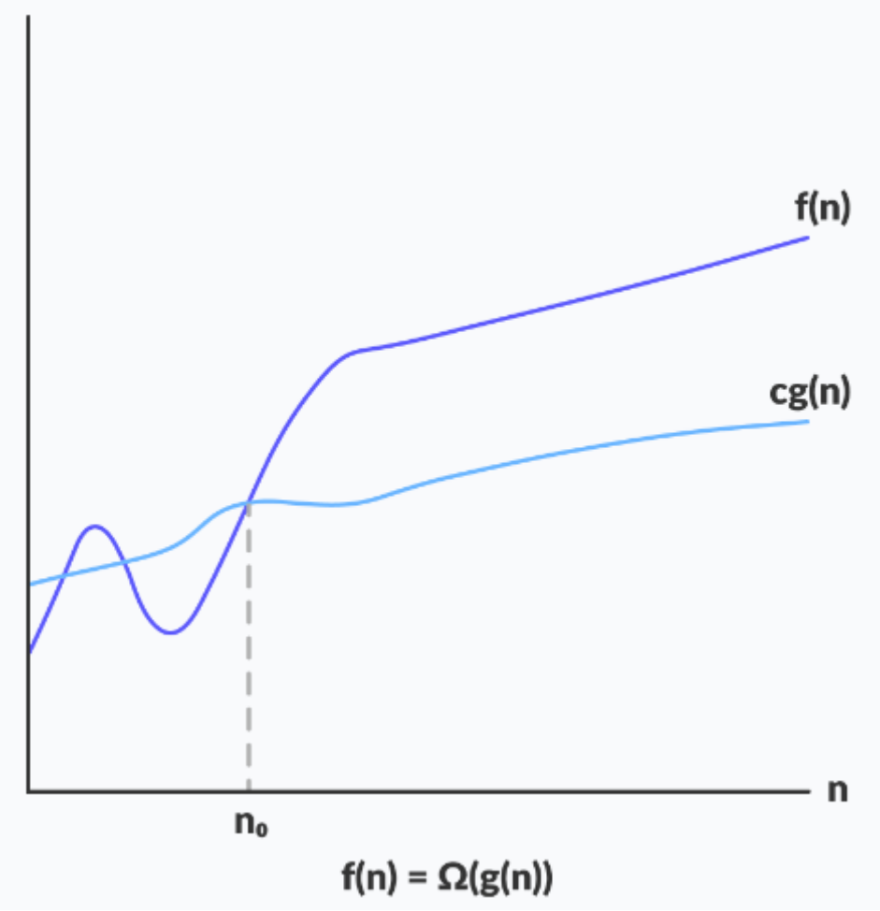

Slide 12
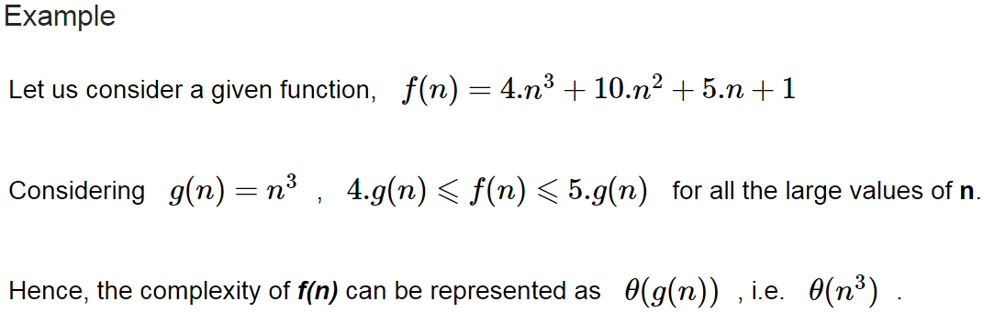
Theta (θ) (Asymptotic Tight Bound)
We say that f(n)=θ(g(n)) when there exist constants c₁ and c₂ that c1.g(n)⩽f(n)⩽c2.g(n) for all sufficiently large value of n. Here n is a positive integer.
This means function g is a tight bound for function f.

Slide 13
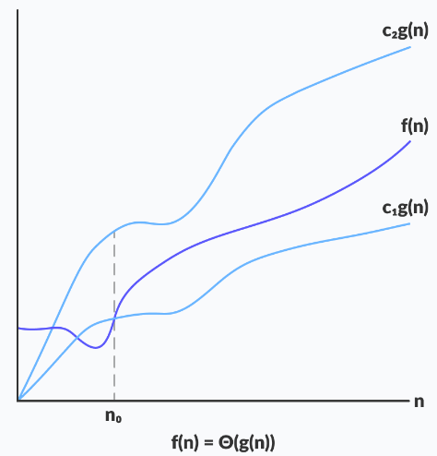

Slide 14
Little ο asymptotic notation
Big-Ο is used as a tight upper-bound on the growth of an algorithm’s effort (this effort is described by the function f(n)), even though, as written, it can also be a loose upper-bound. “Little-ο” (ο()) notation is used to describe an upper-bound that cannot be tight.
Let f(n) and g(n) be functions that map positive integers to positive real numbers. We say that f(n) = ο(g(n)) if for any real constant c > 0, there exists an integer constant n0 ≥ 1 such that 0 ≤ f(n) < c*g(n).

Slide 15
Little ω asymptotic notation
Let f(n) and g(n) be functions that map positive integers to positive real numbers. We say that f(n) = ω(g(n)) if for any real constant c > 0, there exists an integer constant n0 ≥ 1 such that f(n) > c * g(n) ≥ 0 for every integer n ≥ n0.
f(n) has a higher growth rate than g(n),so main difference between Big Omega (Ω) and little omega (ω) lies in their definitions:
  In the case of Big Omega f(n)=Ω(g(n)) and the bound is 0<=c*g(n)<=f(n),
  but in case of little omega, it is true for 0<=c*g(n)<f(n).

Slide 16
REFERENCES
Text books:
Cormen, Leiserson, Rivest, Stein, “Introduction to Algorithms”, Prentice Hall of India, 3rd edition 2012. problem, Graph coloring.
Horowitz, Sahni and Rajasekaran, “Fundamentals of ComputerAlgorithms”, University Press (India), 2nd edition
Websites:
https://www.tutorialspoint.com/design_and_analysis_of_algorithms/design_and_analysis_of_algorithms_asymptotic_notations_apriori.htm

Slide 17
Summary
Complexity of algorithm
  Time and space Complexity
  Various Asymptotic Notations

Slide 18
THANK YOU

